Slide 1
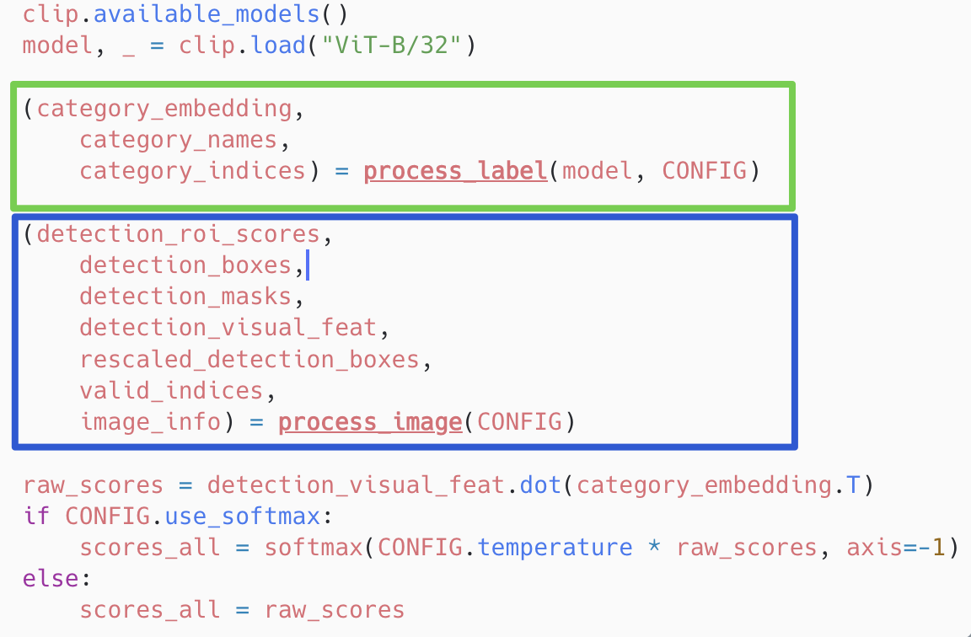
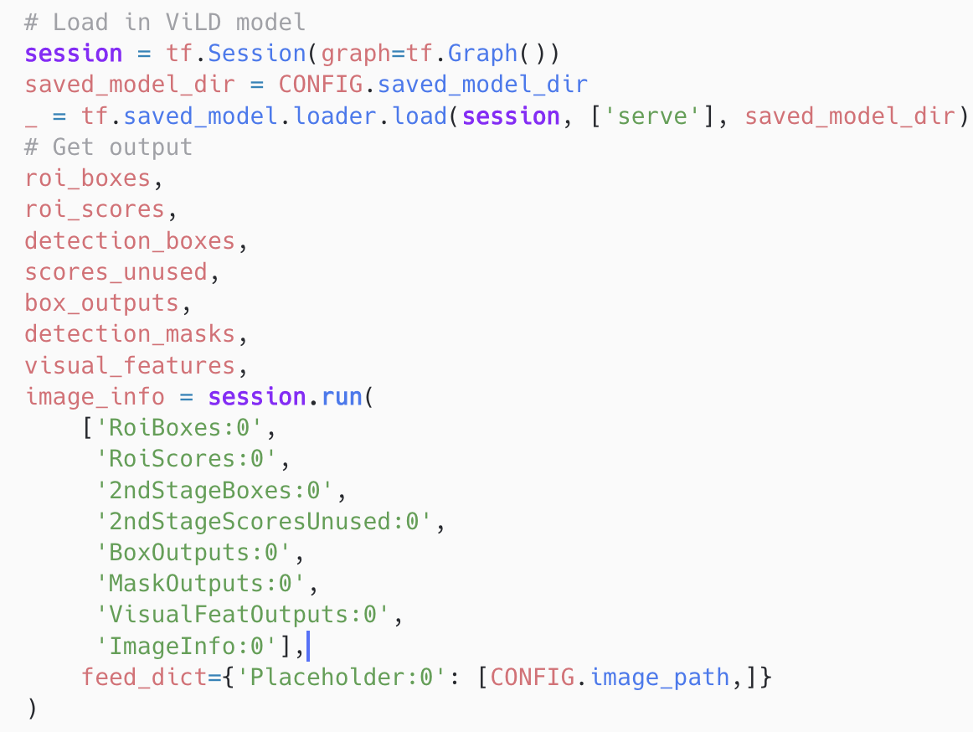
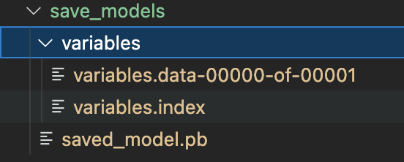
Why we can not change the ViLD’s backbone in Alex repo
CLIP
Object detection

Slide 2
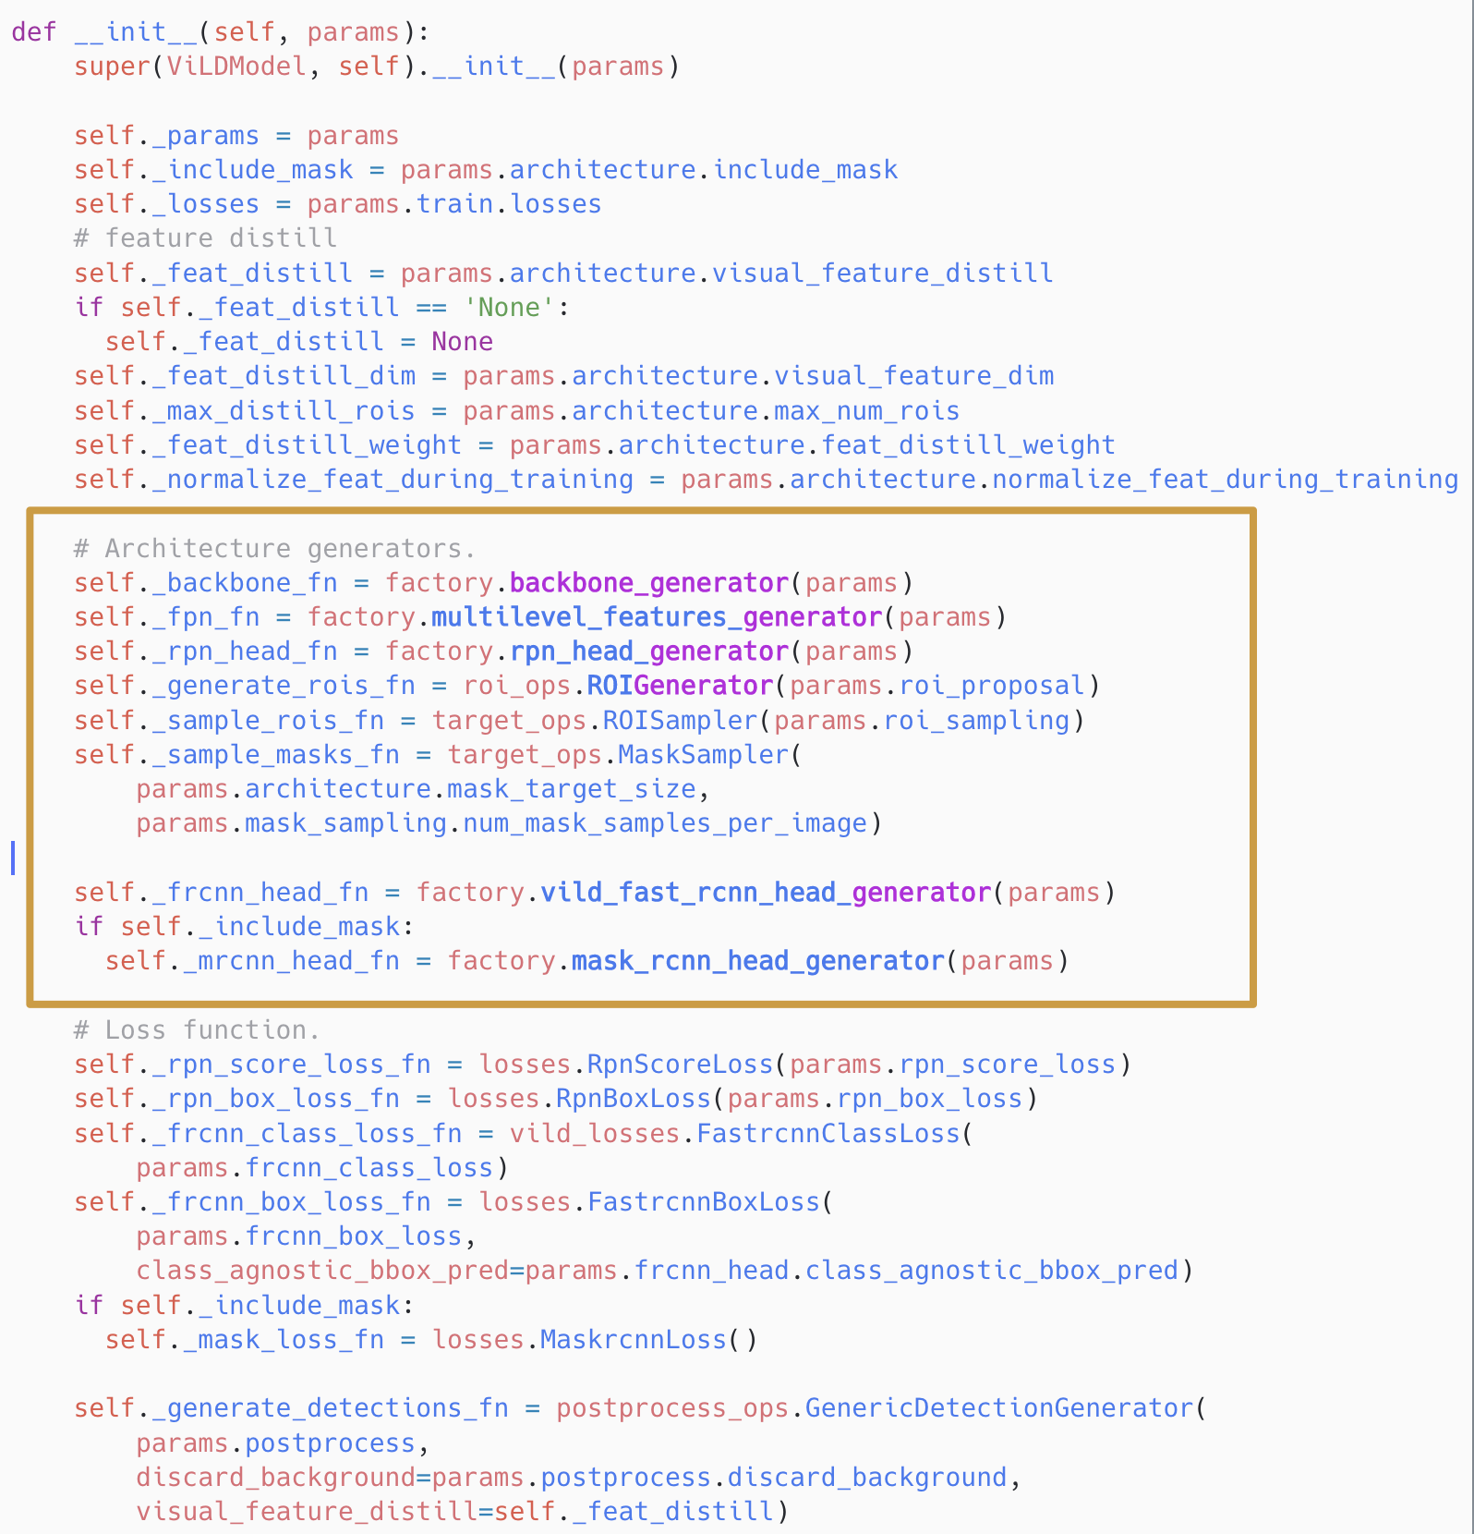
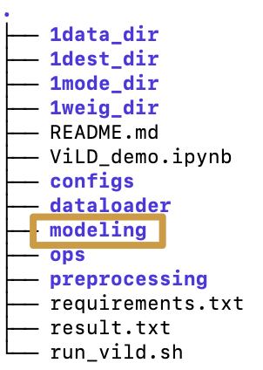
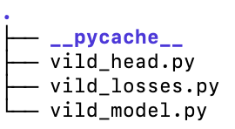
How to change the ViLD’s backbone (tpu/) tpu/models/official/detection/projects/vild at master · tensorflow/tpu (github.com) Object Detection Part:
class ViLDFastrcnnHead(object):
class FastrcnnClassLoss(object):
class ViLDModel(base_model.BaseModel):

Slide 3
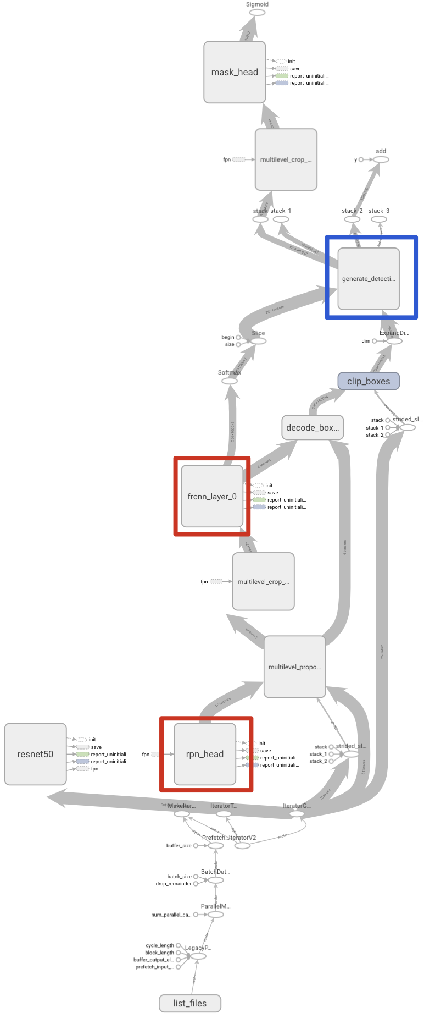
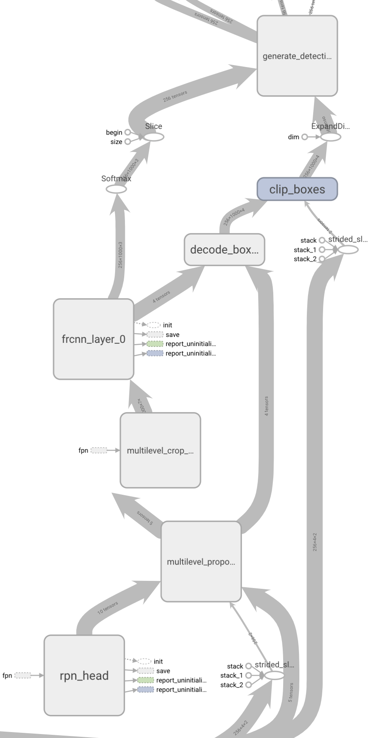
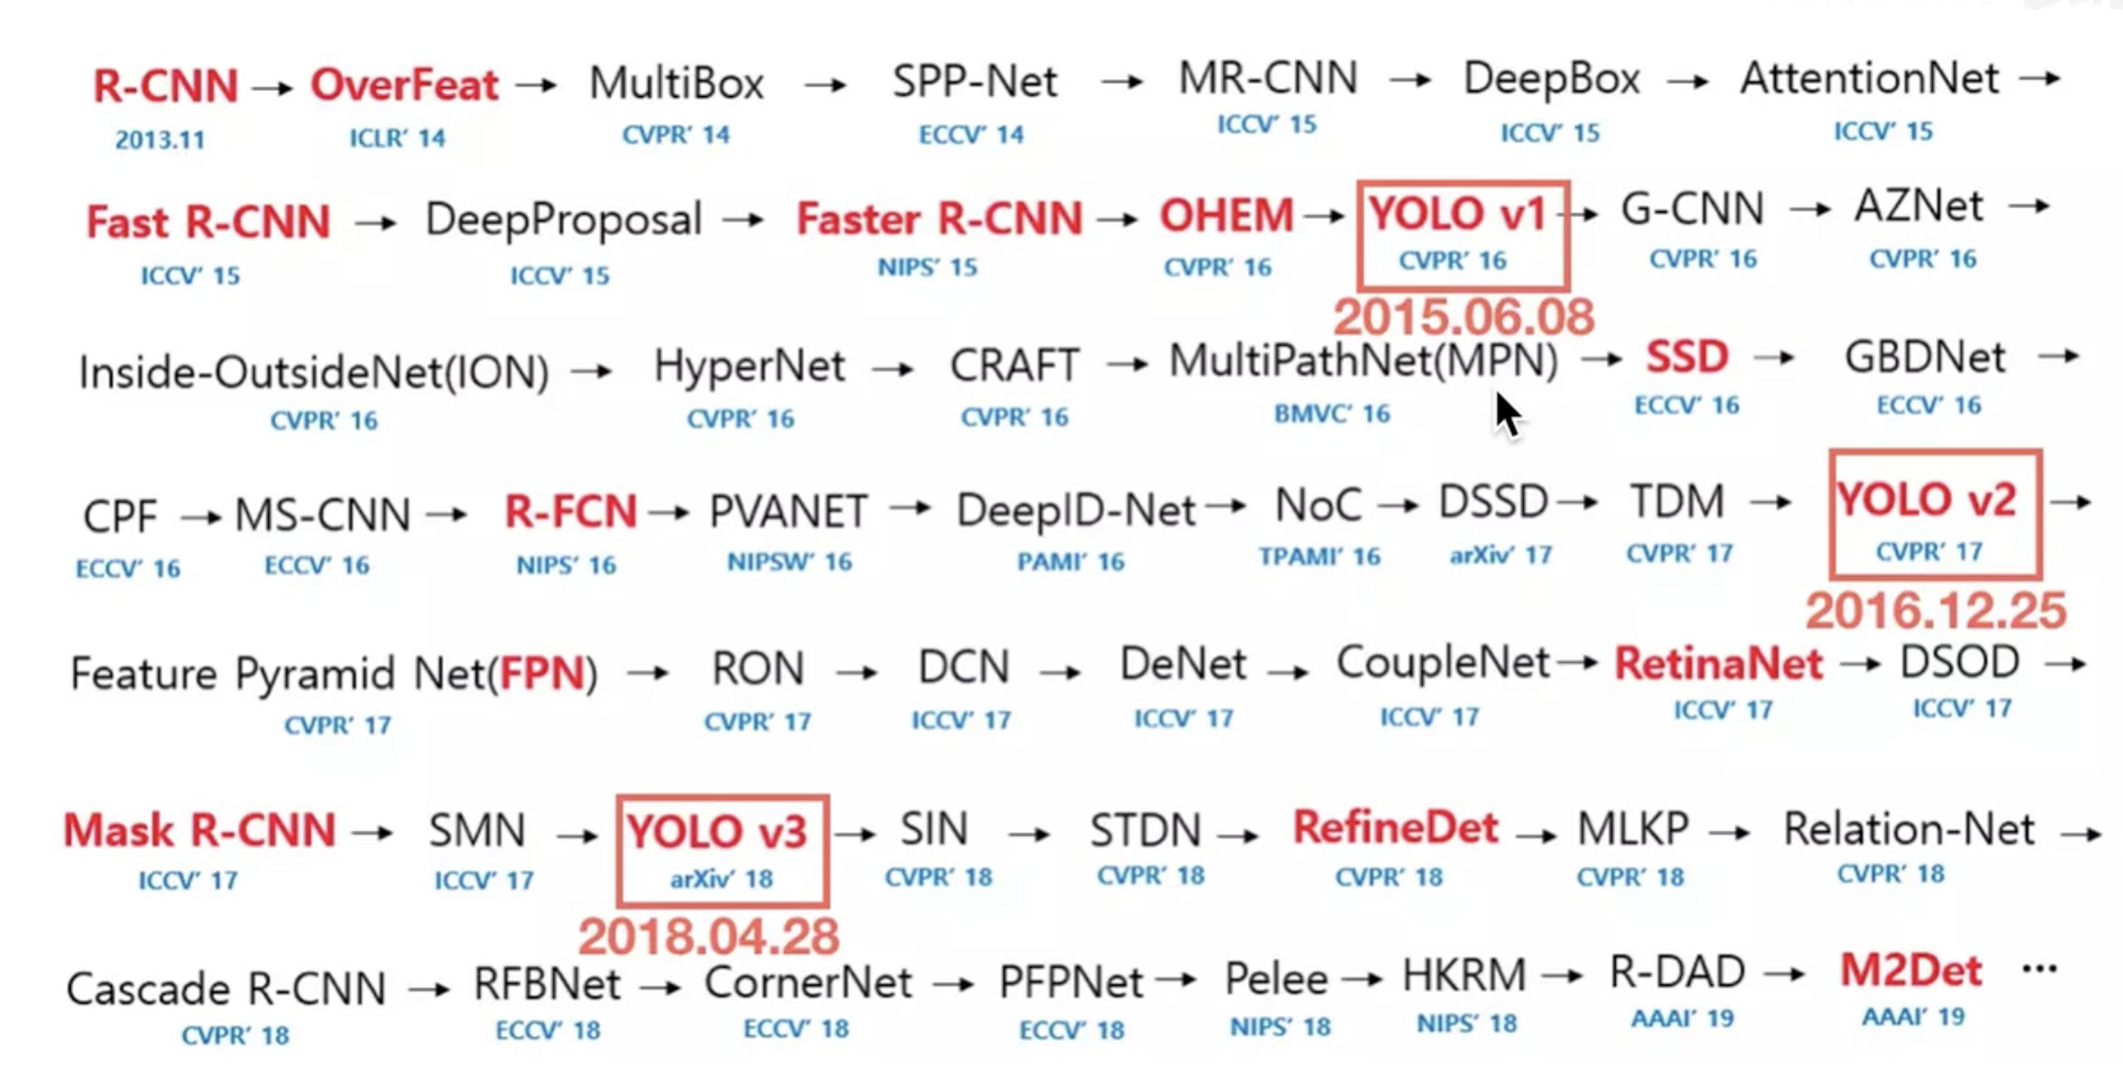
How to change the ViLD’s backbone Object Detection Part:
1. YOLO Series √
2. Fast R-CNN / Mask R-CNN
-> Cascade R-CNN …
（Generalized Focal Loss） √
3. SSD X

Slide 4
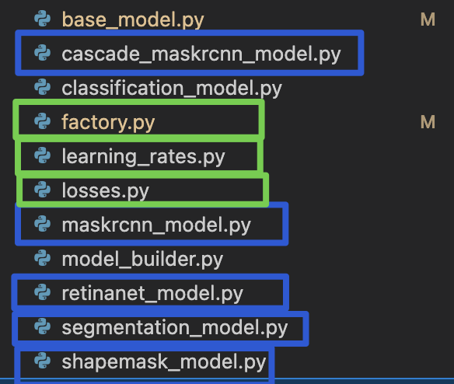
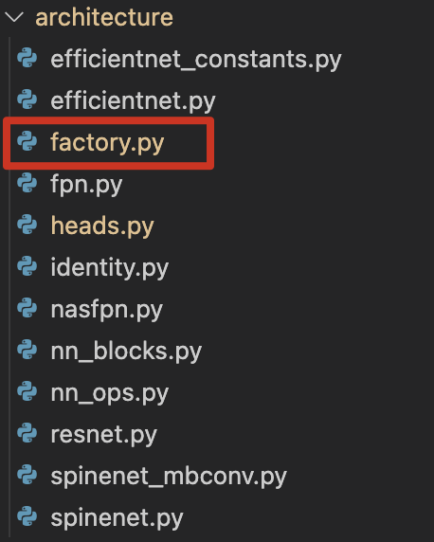
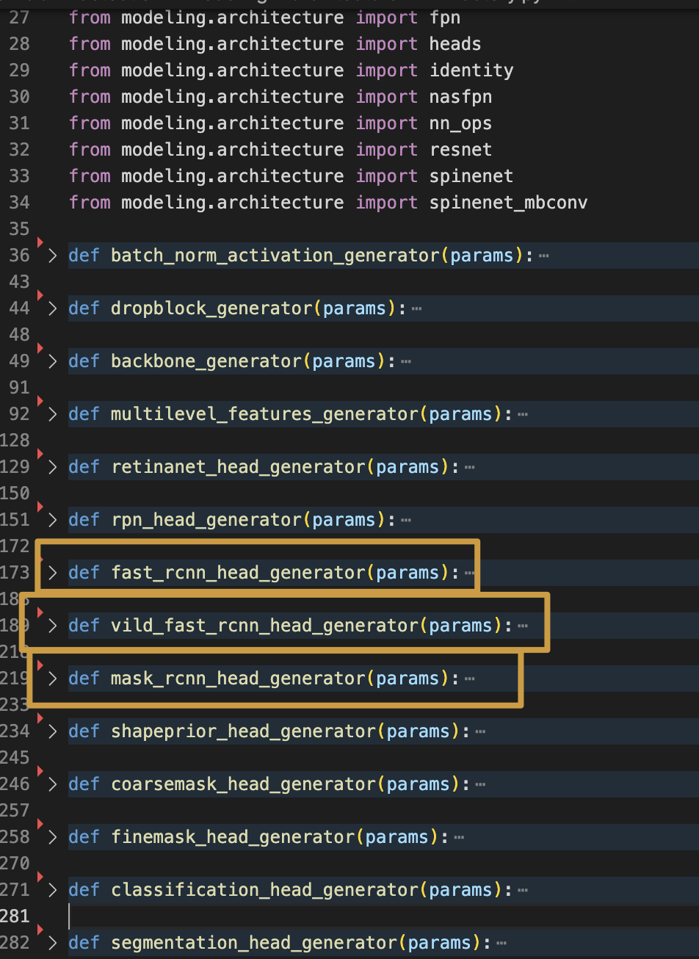
About the idea to add a model(generator)/layer
deeper
deeper
Still work on Netron and try to investigate deeper
Add: I neglected an option all the time:
To embed the ViLD Frcnn parts into Alex’s repo directly. It should be the next step to try. Then, try to change them into other backbones.

